Slide 1
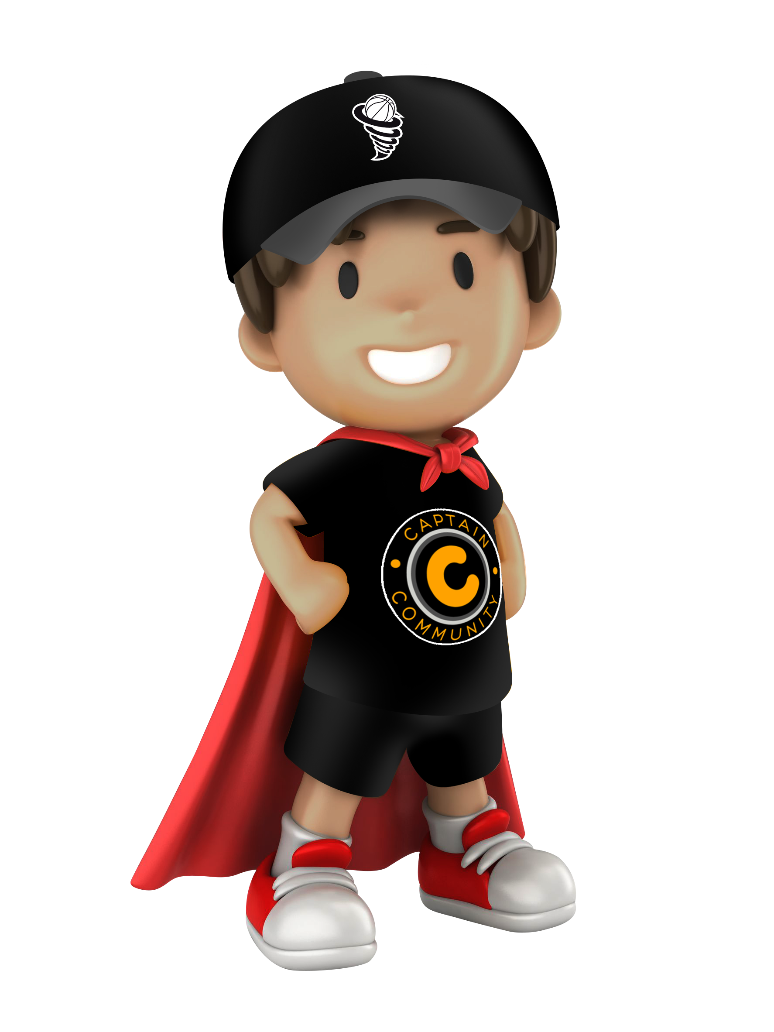

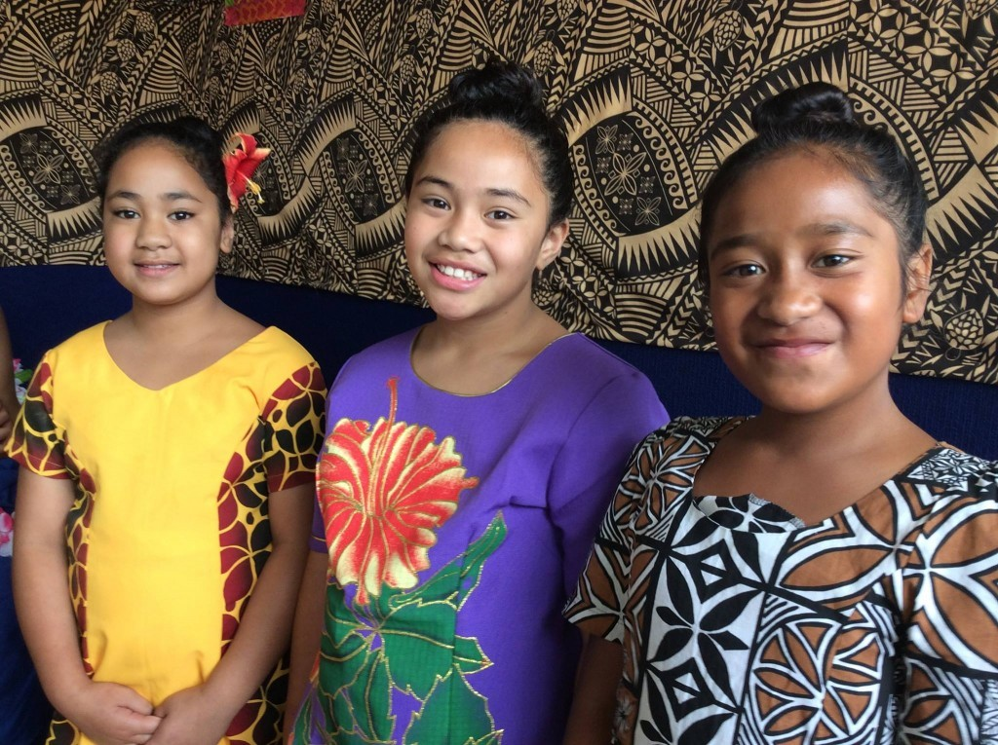
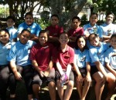

(JNS) Junior Neighbourhood Support
Program

Slide 2
What is Junior Neighbourhood Support?
Mission Statement:
Junior Neighbourhood Support aims to make our homes, streets, neighbourhoods and communities safer and more caring places in which to live by fostering contact, understanding and friendliness between neighbours.
We foster friendly caring Youth communities to achieve:
Crime Awareness & Reduced Youth Offending
A Safer & More Inclusive Youth Community
Emergency & Disaster Preparedness Co-ordination

Slide 3
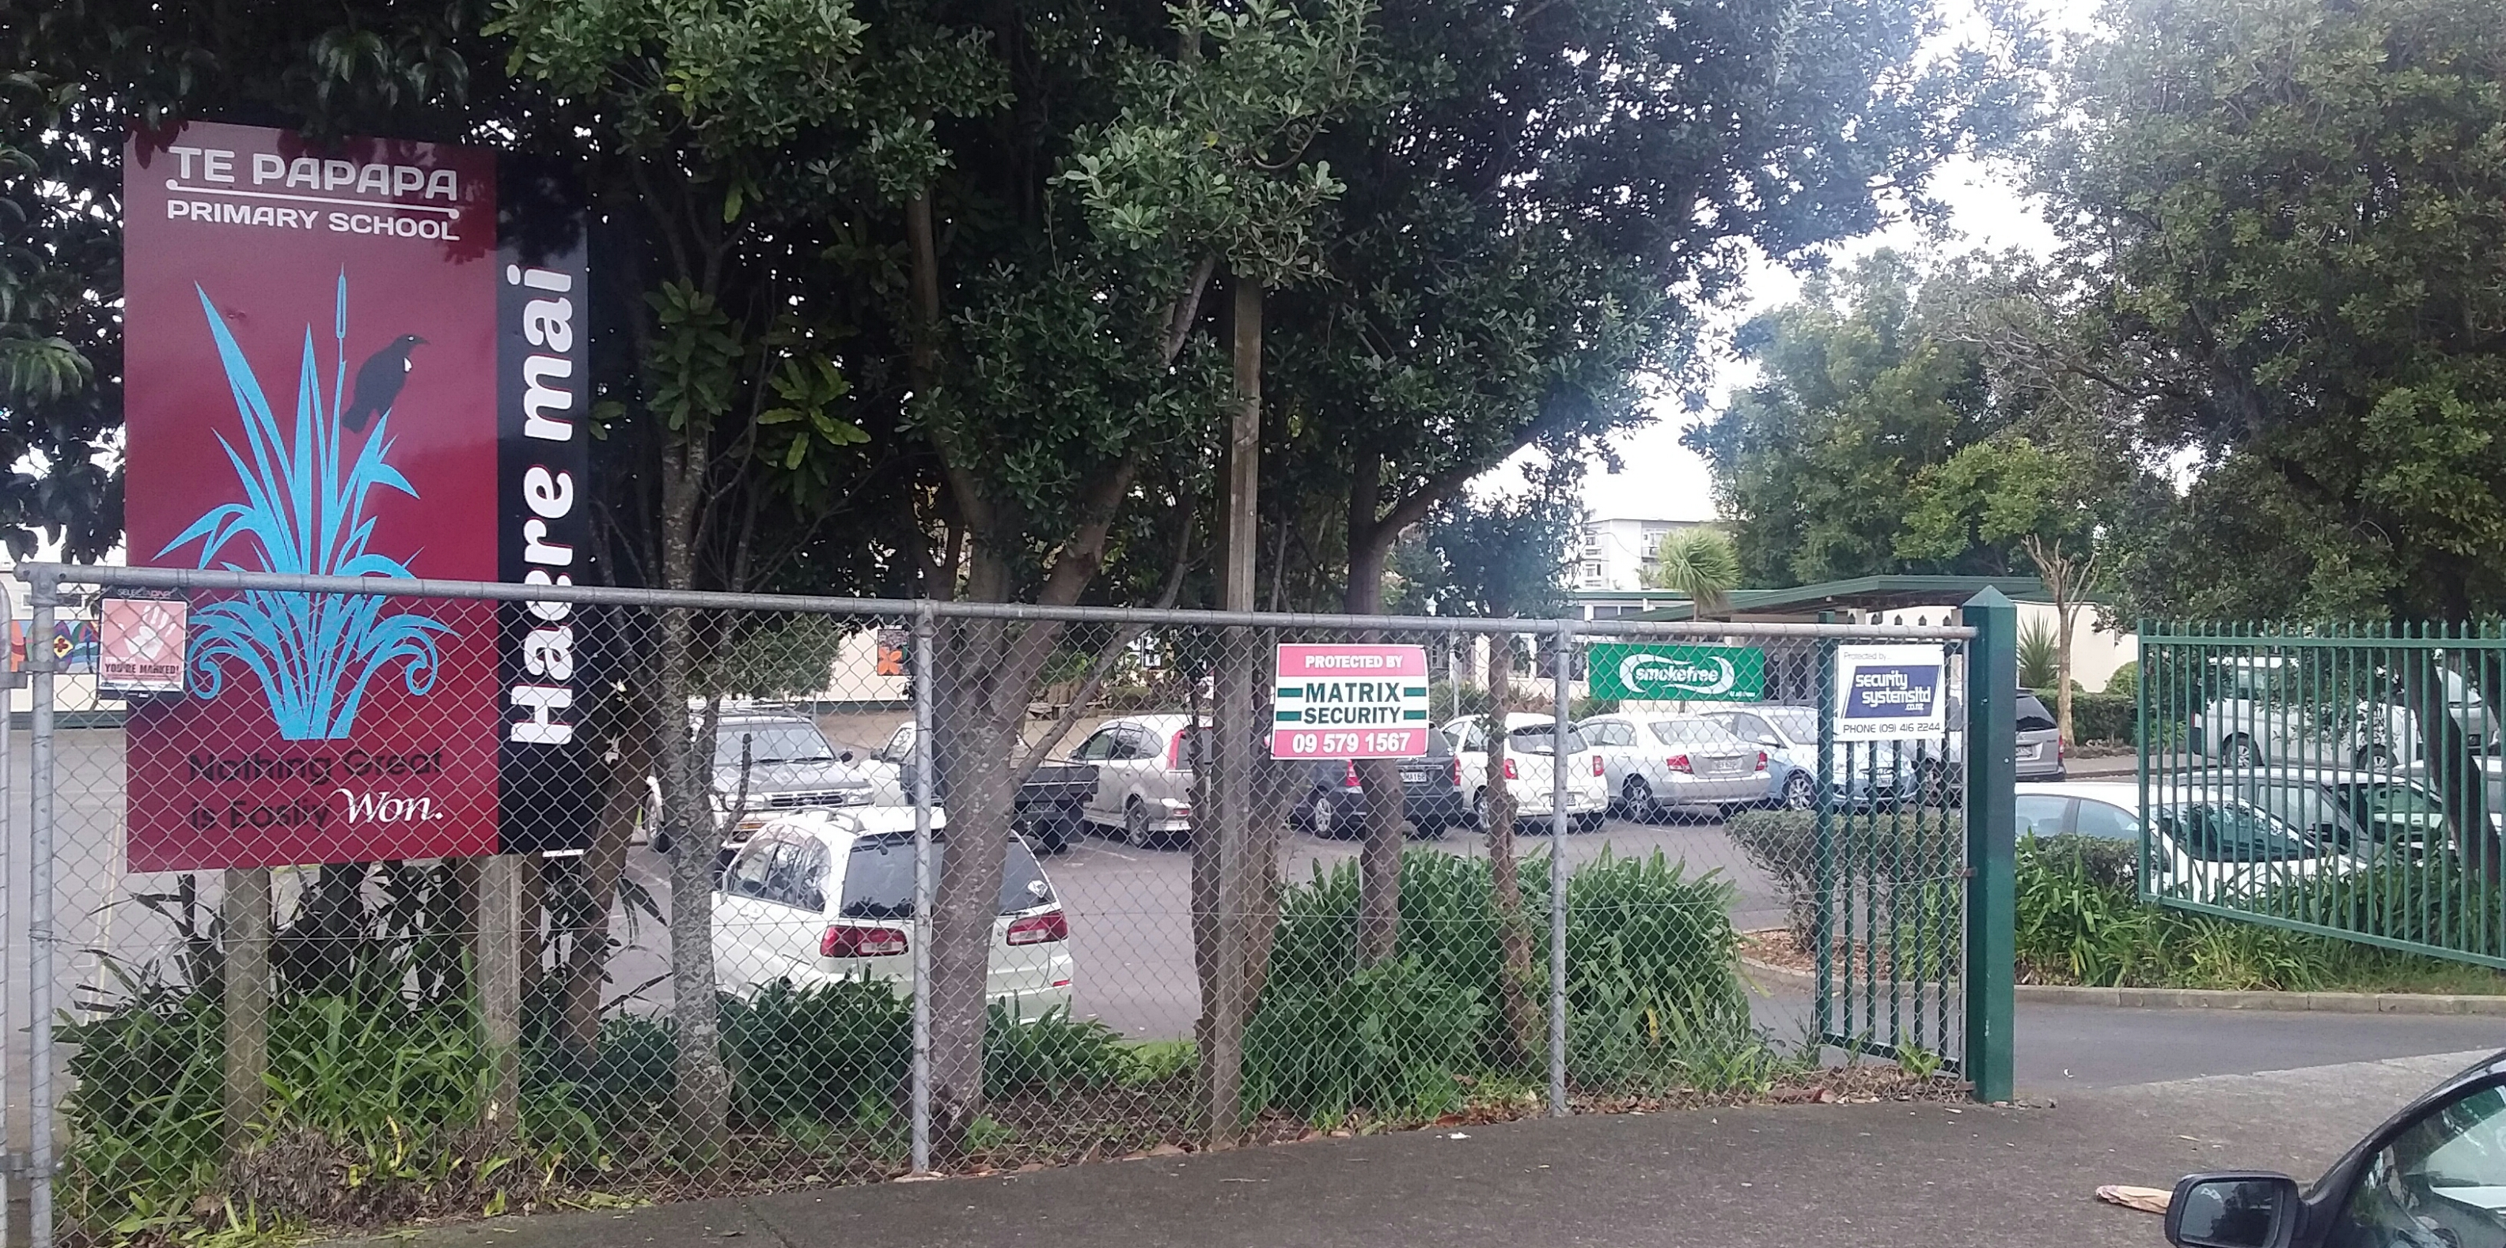
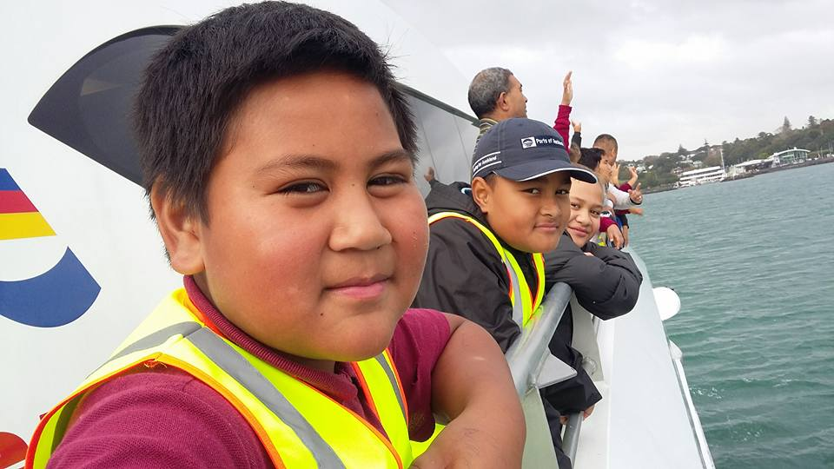
Junior Neighbourhood Support
…. Core Values and Kau papa
Self Respect/ Pride and Giving Respect of others and Supporting Community Rules
Identifying and preventing bullying; helping others who are bullied or Harmed
Pride in our school/home/community
Encouraging environmental awareness within our school, at home and in the community
Learning and respecting the cultural identity of our school, home and community

Slide 4
How Do We Achieve These Goals?
….By forming Junior Neighbourhood Support Groups
Promote Junior NS Groups based out of Local Schools
Distribute Program & Resources for Teachers & Parents
Encourage Schools to Form Junior NS Groups
Students Watch Out for Each Others Safety and Property
Create Awareness about the Junior Neighbourhood Support
Join Activities – Street parties, Barbeques, Graffiti and Community Patrols.

Slide 5
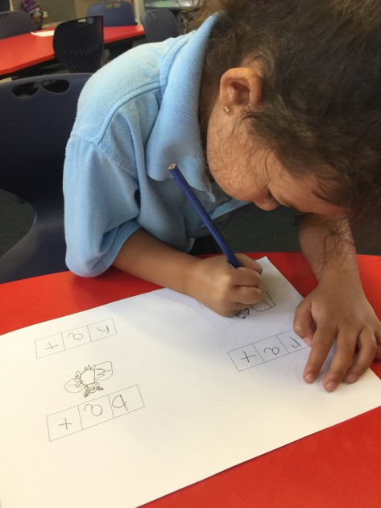
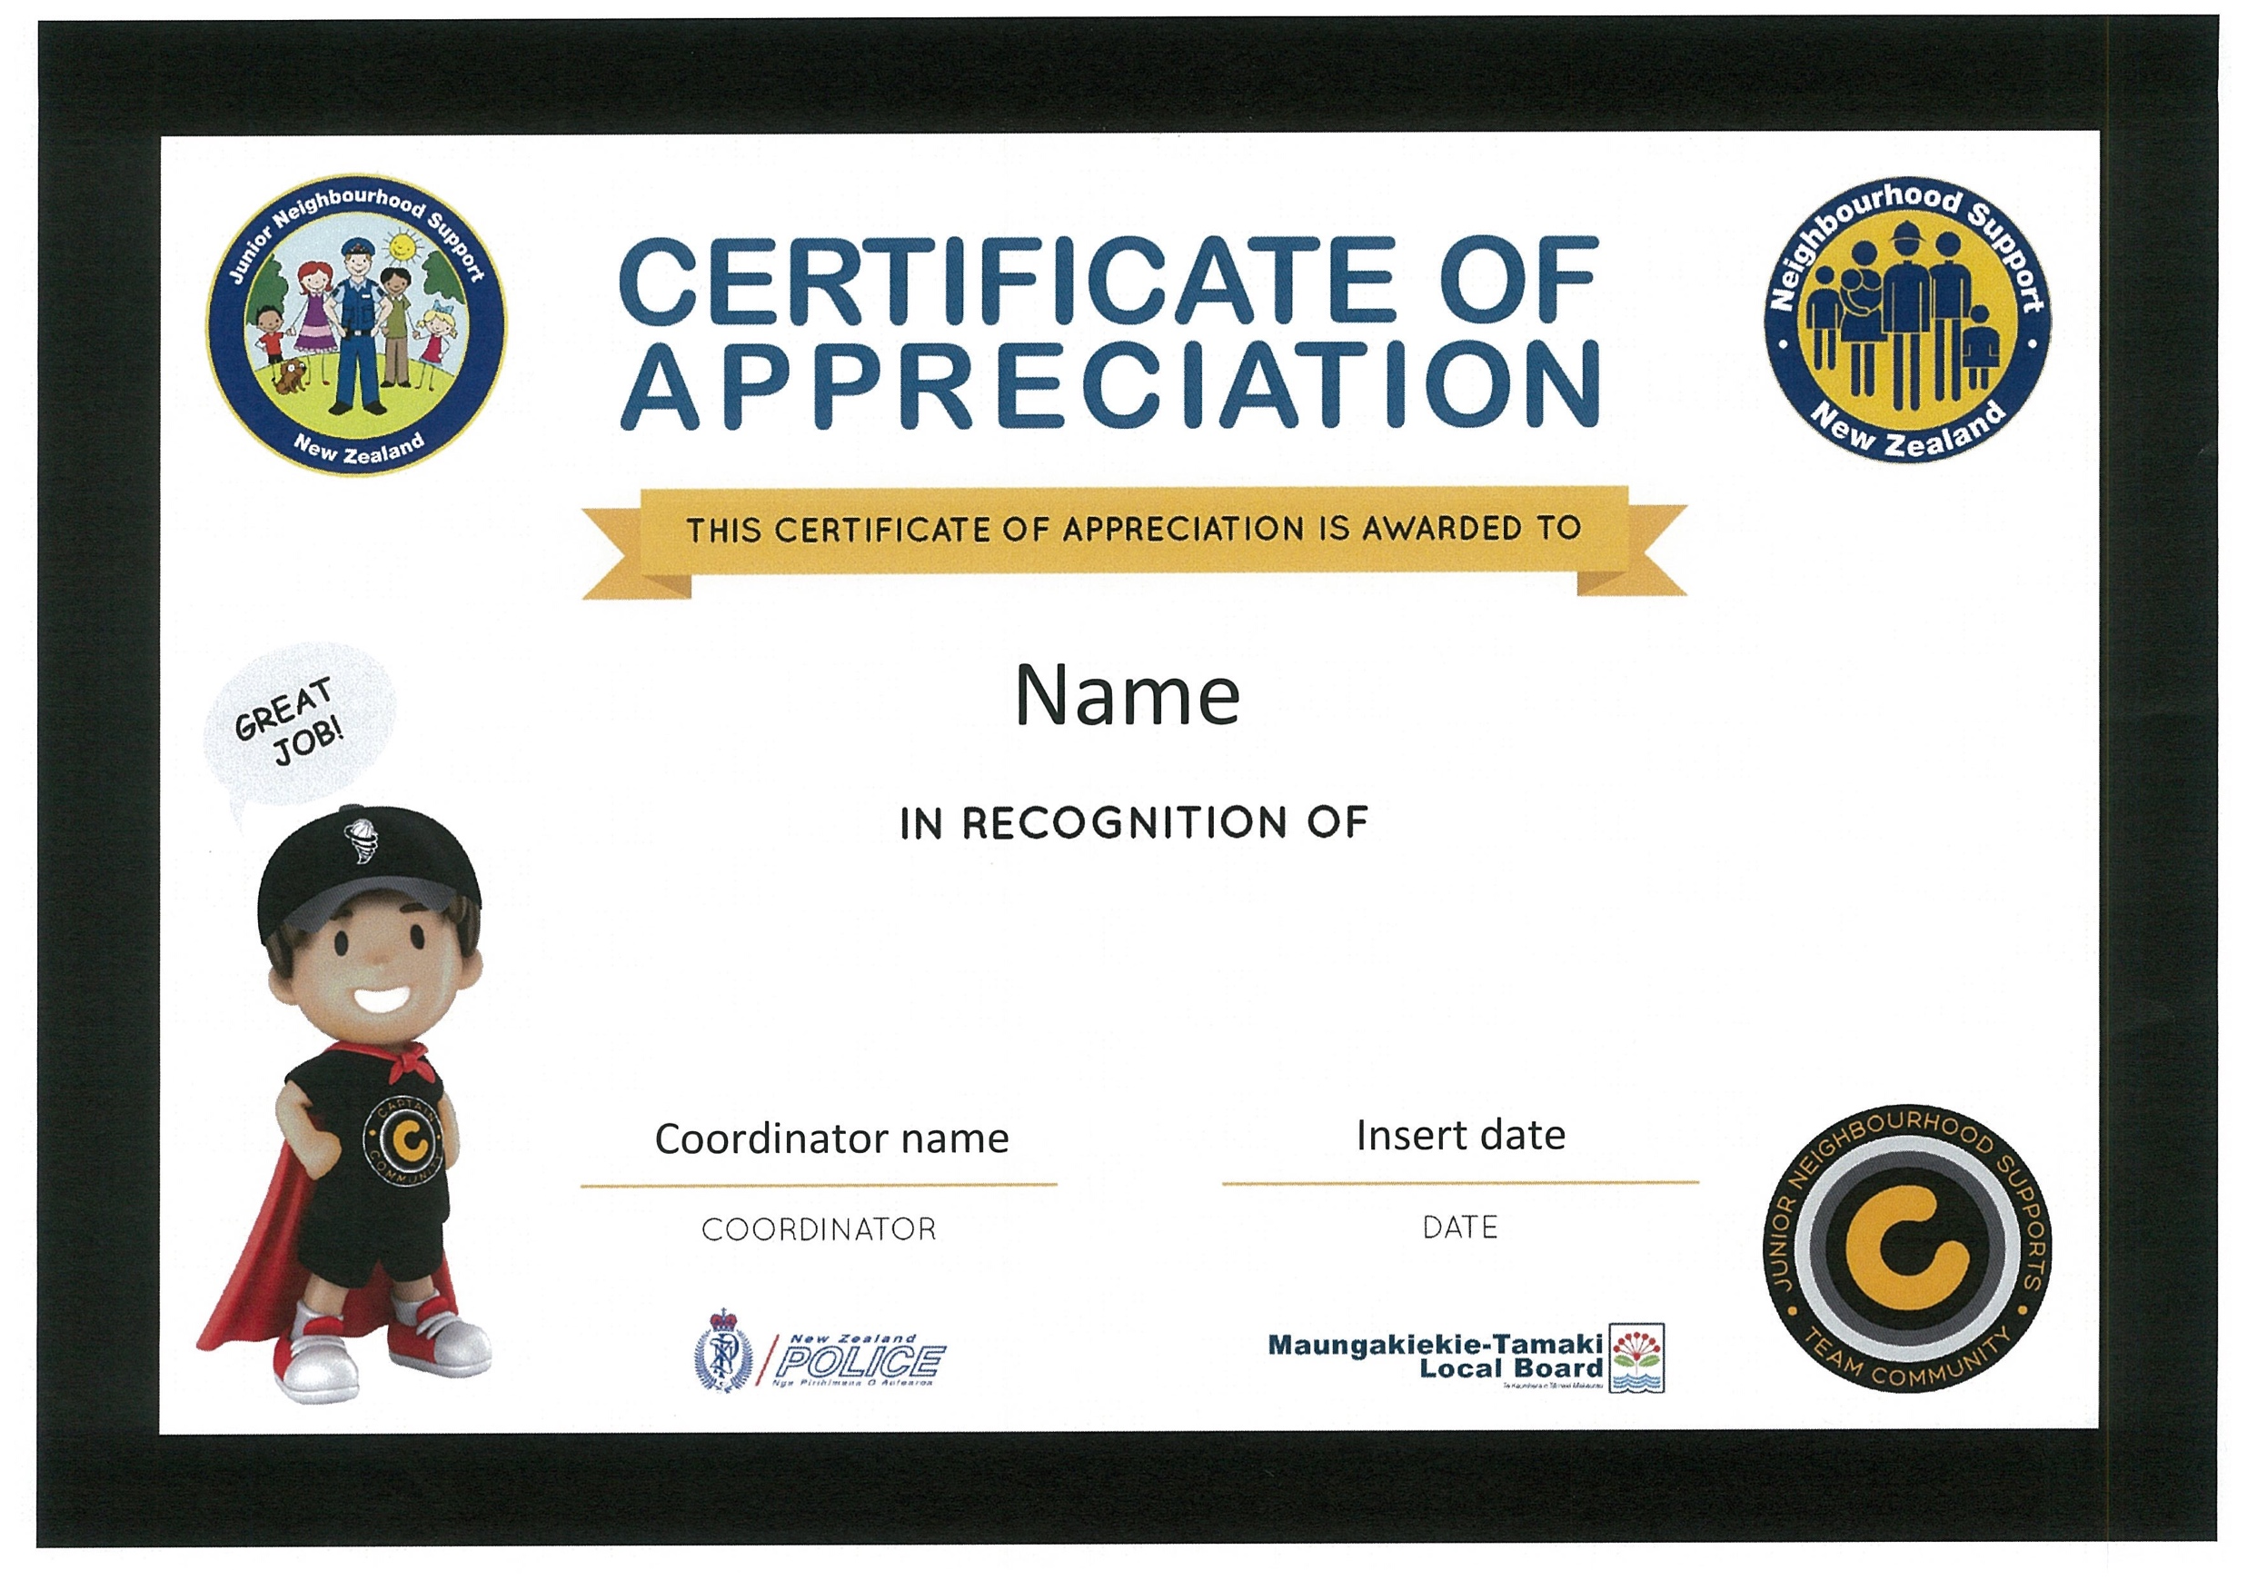

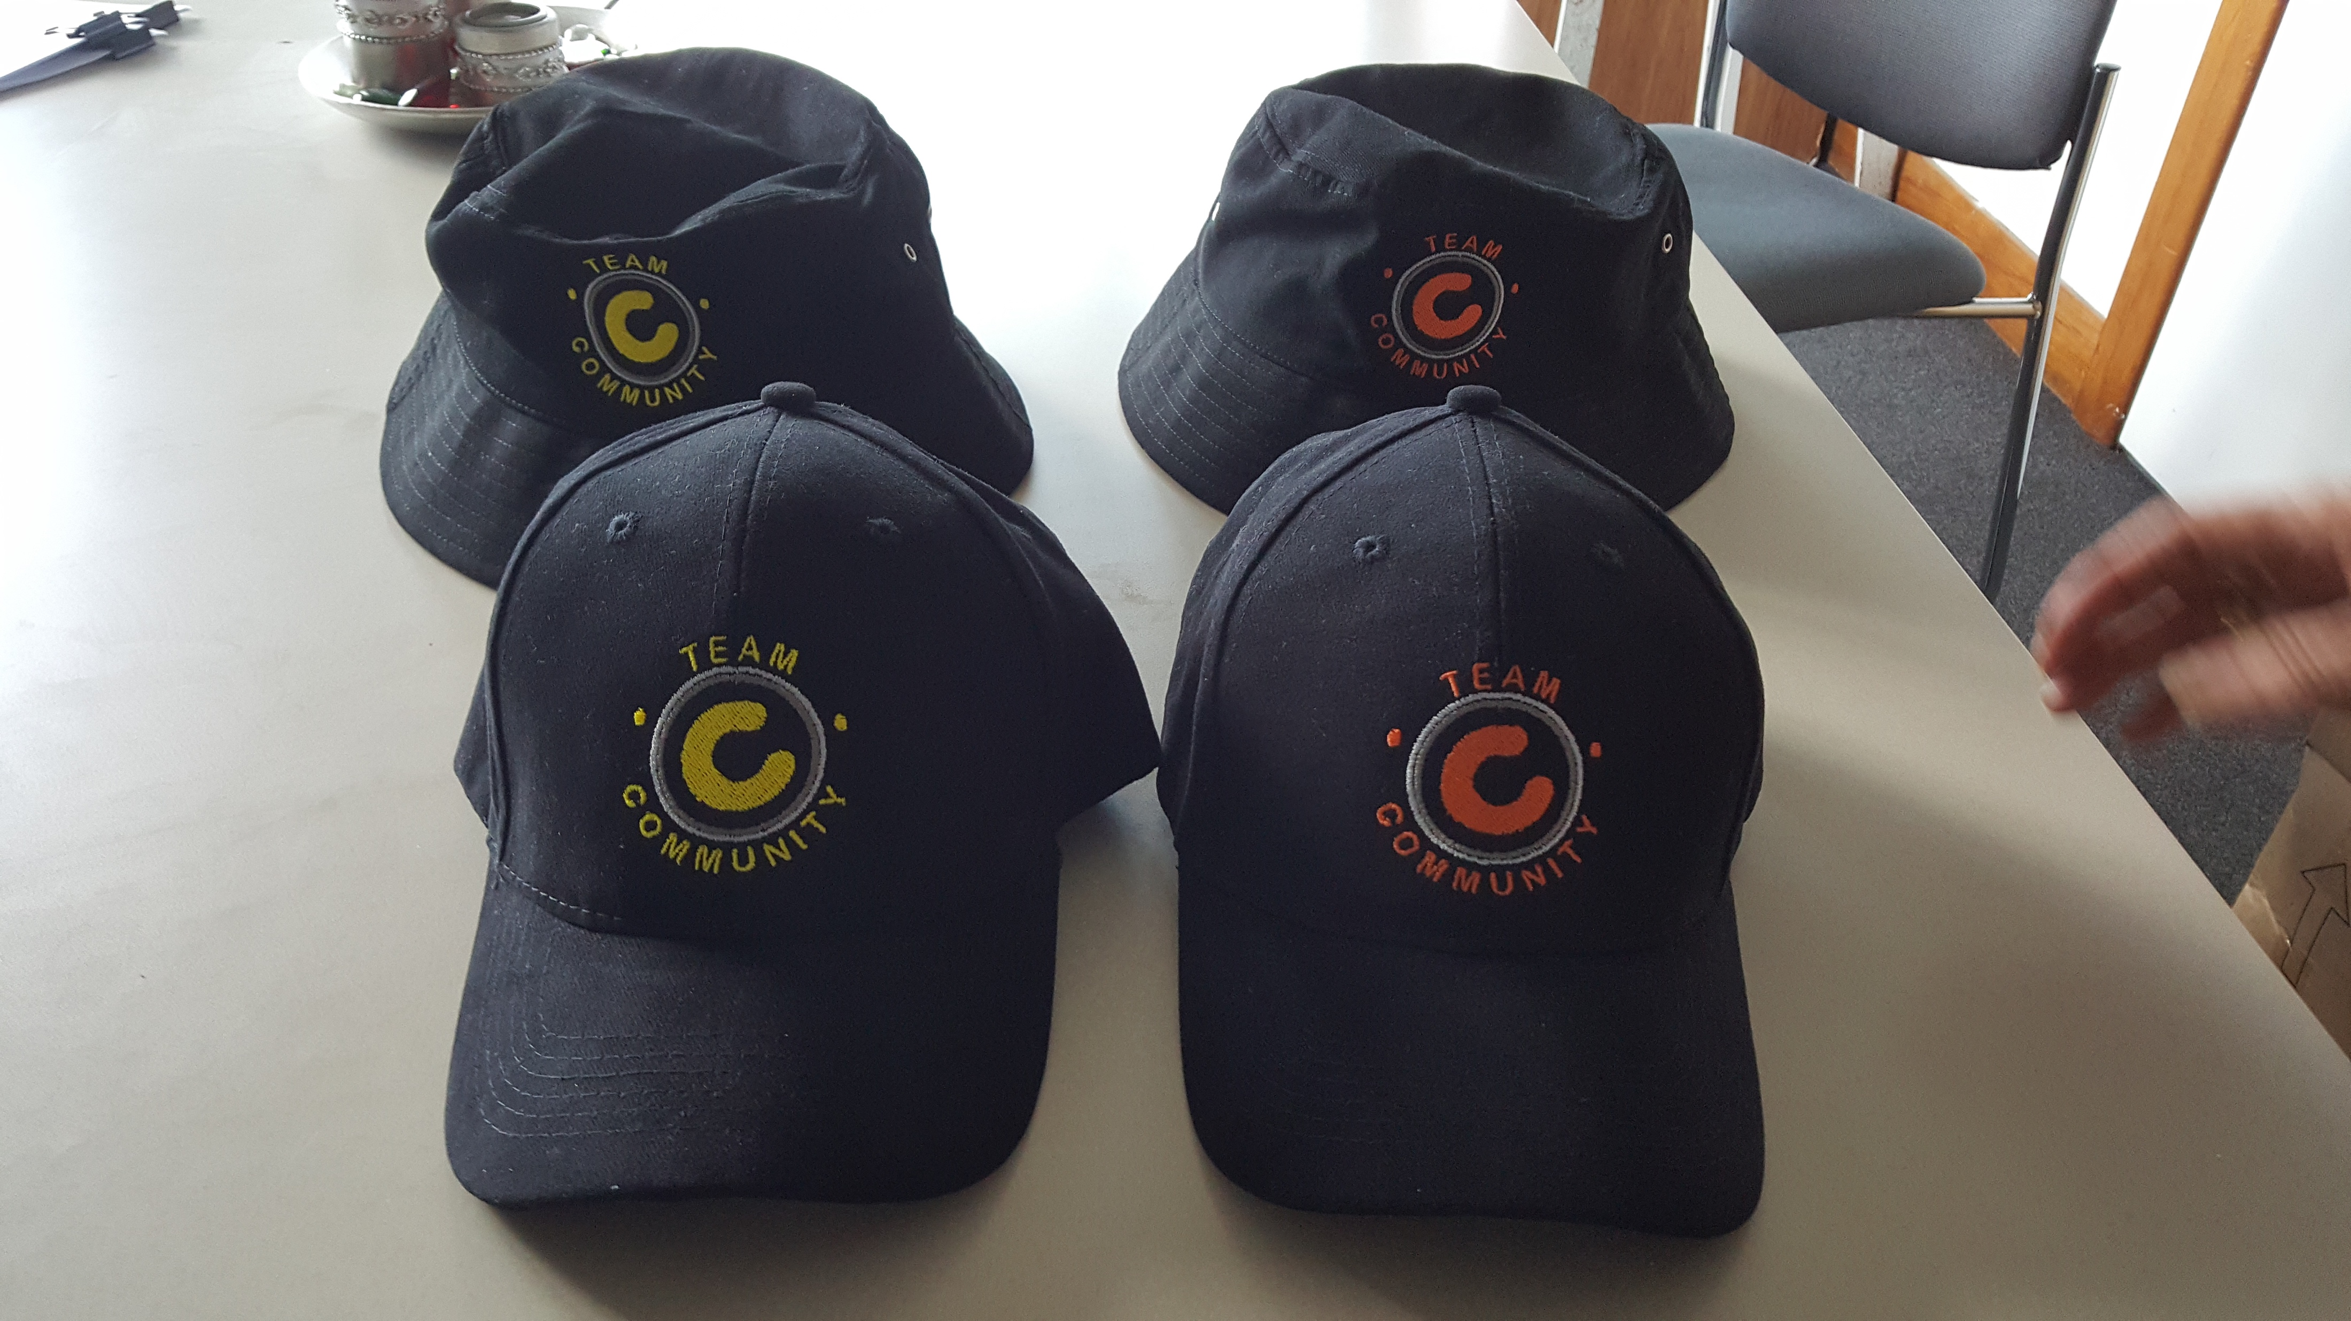

The JNS Learning Program
Includes….
A three Module, Fifteen Point (Mission) JNS Teachers Guide
Awards (certificates, caps, badges) for students demonstrating participation
Teacher record student progress through activities and feedback to JNS

Slide 6

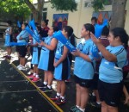
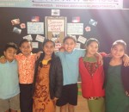
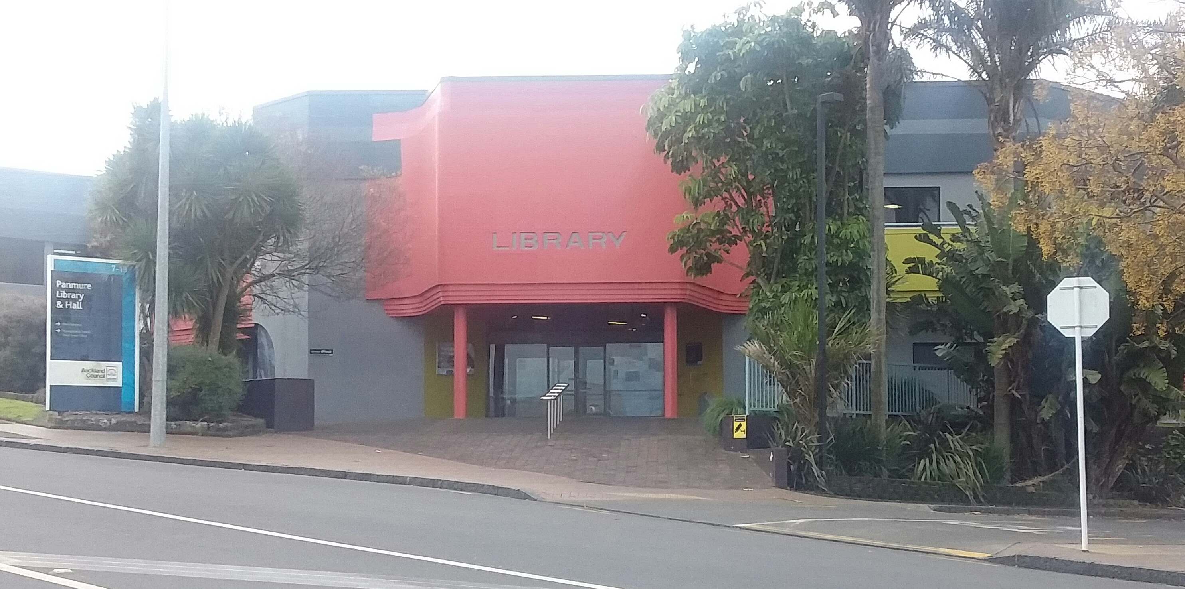
Activity Or Mission Based Learning
Doing things at….
School ( JNS Missions 1-5 )
Home ( JNS Missions 6-10 )
Community ( JNS Missions 11-15 )

Slide 7
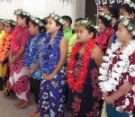
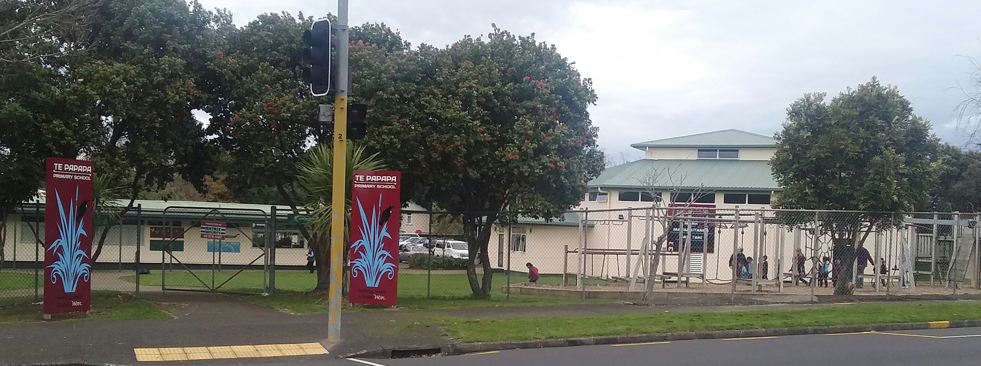
School Activity Missions 1-5
Activity Focus | Missions Details
1. Personal Pride & Respect | Wearing of Uniform appropriately, Being Respectful , Following School Rules
2. Preventing Bullying | Identifying Reporting Bullying behaviour, Helping those who have been Bullied
3. Pride In Our School | Keeping School Grounds clean, Reporting Hazard's and Damage at School
4. Care for the Environment | Becoming involved in School Environmental and initiatives
5. Cultural Awareness | Learning about the Different Cultures and History of the School

Slide 8
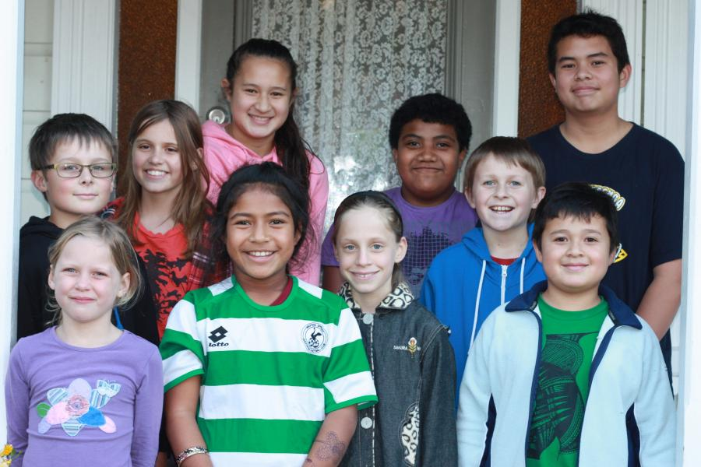

Home Activity Missions 6-10
Activity Focus | Missions Details
6. Personal Pride & Respect | Keeping your Room Tidy, Being Respectful to family, Following Parents Instructions
7. Developing Safety Plans | Develop a Family Evacuation Plan, Create a Home Emergency Survival Kit
8. Know Your Own Details | Home Address, Family Phone Numbers, Other Relative’s Phone number
9. Safety & Crime Prevention | Locking your Home, Smoke detectors, Escape routes and Electrical Safety
10. Cultural Awareness | Learning about the Cultures within Your Family and Neighbourhood

Slide 9
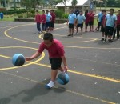
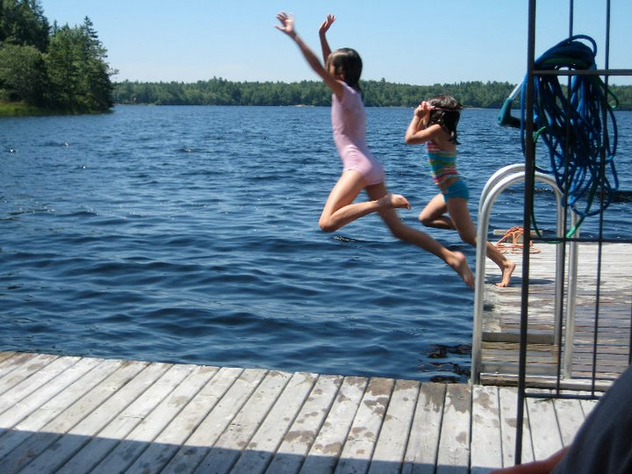
Community Activity Missions 11-15
Activity Focus | Missions Details
11. Pride & Respect | Being Respectful to Neighbours and Public, Helping Parents with Garden & Home
12. Knowing Your Neighbours | Know your Neighbours name and Phone number, Report if they need Help
13. Knowing Your Community | Know the Location of nearby Fire, Ambulance and Police Stations
14. Local Environmental | Keep your Local Parks and streets Clean, Join local Community Support Groups
15. Cultural Awareness | Learn about the Community Cultures and History of the Neighbourhood

Slide 10

Additional Support & Resources
…. And
JNS Web Site for Teachers to Download the Materials
Support Social Hubs e.g. Facebook, Instagram, Snapchat.. etc
Online support Gateway to schools, families and communities
Teachers will be backed by a JNS School Co-ordinator and Police
Further Facilitate & collaboration between schools, communities & homes
Providing Coverage to Regional / National schools for free
Act as a database and collection of information and feedback

Slide 11
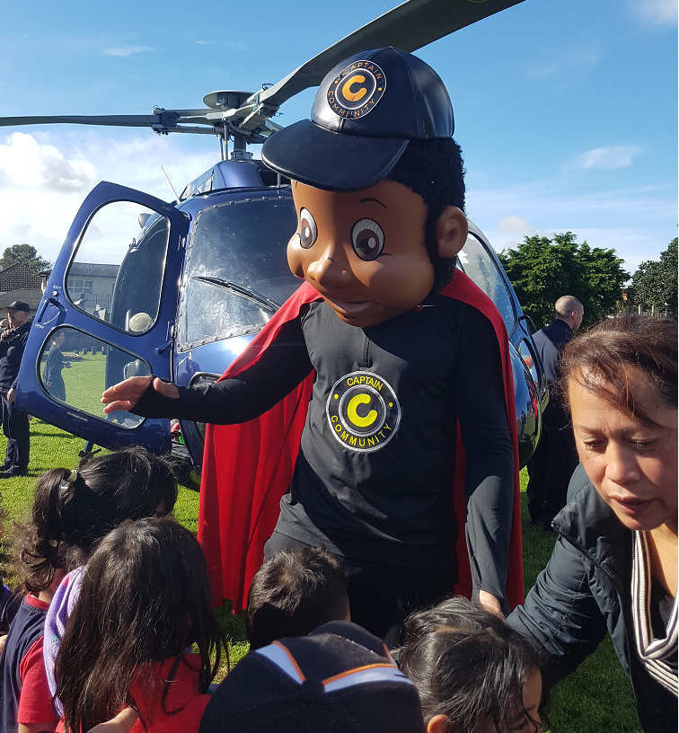
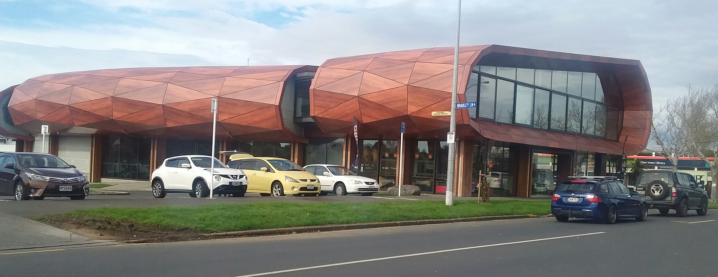
Strategic Alignment
Maungakiekie-Tamaki Local Board Safety Plan
NZ Police Prevention First Strategy
Neighbourhood Support Auckland Strategic Plan

Slide 12
Program Team & Working Group
Annie Heem, Avon Lines, Neighbourhood Support Auckland
Sgt Dean McEntee, S/Sgt Wayne Kitcher, NZ Police
Michelle Amopiu, Better Way Foundation Glen Green, (Field Coordinator for the JNS Pilot Program )
Michael Alofa, Auckland Council

Slide 13




Our Partners & Supporters
Maungakiekie-Tamaki Local Board
Auckland City District Police
Neighbourhood Support Auckland
Local Schools
Auckland Council
There’s a Better Way Foundation

Slide 14
Notes
Health and Safety

